Slide 1

How to Really use Udio Part 1

Slide 2
What is covered
What is Udio?
Getting Started
A Tour of the Environment
The Importance of Good Prompts
Creating Music
Working with Advanced Features
Remixing
Extending

Slide 3
What is Udio?

Slide 4
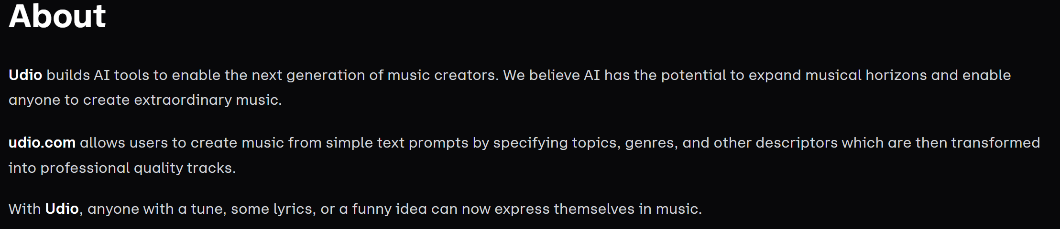
Notes:
https://www.udio.com/about-us

Slide 5
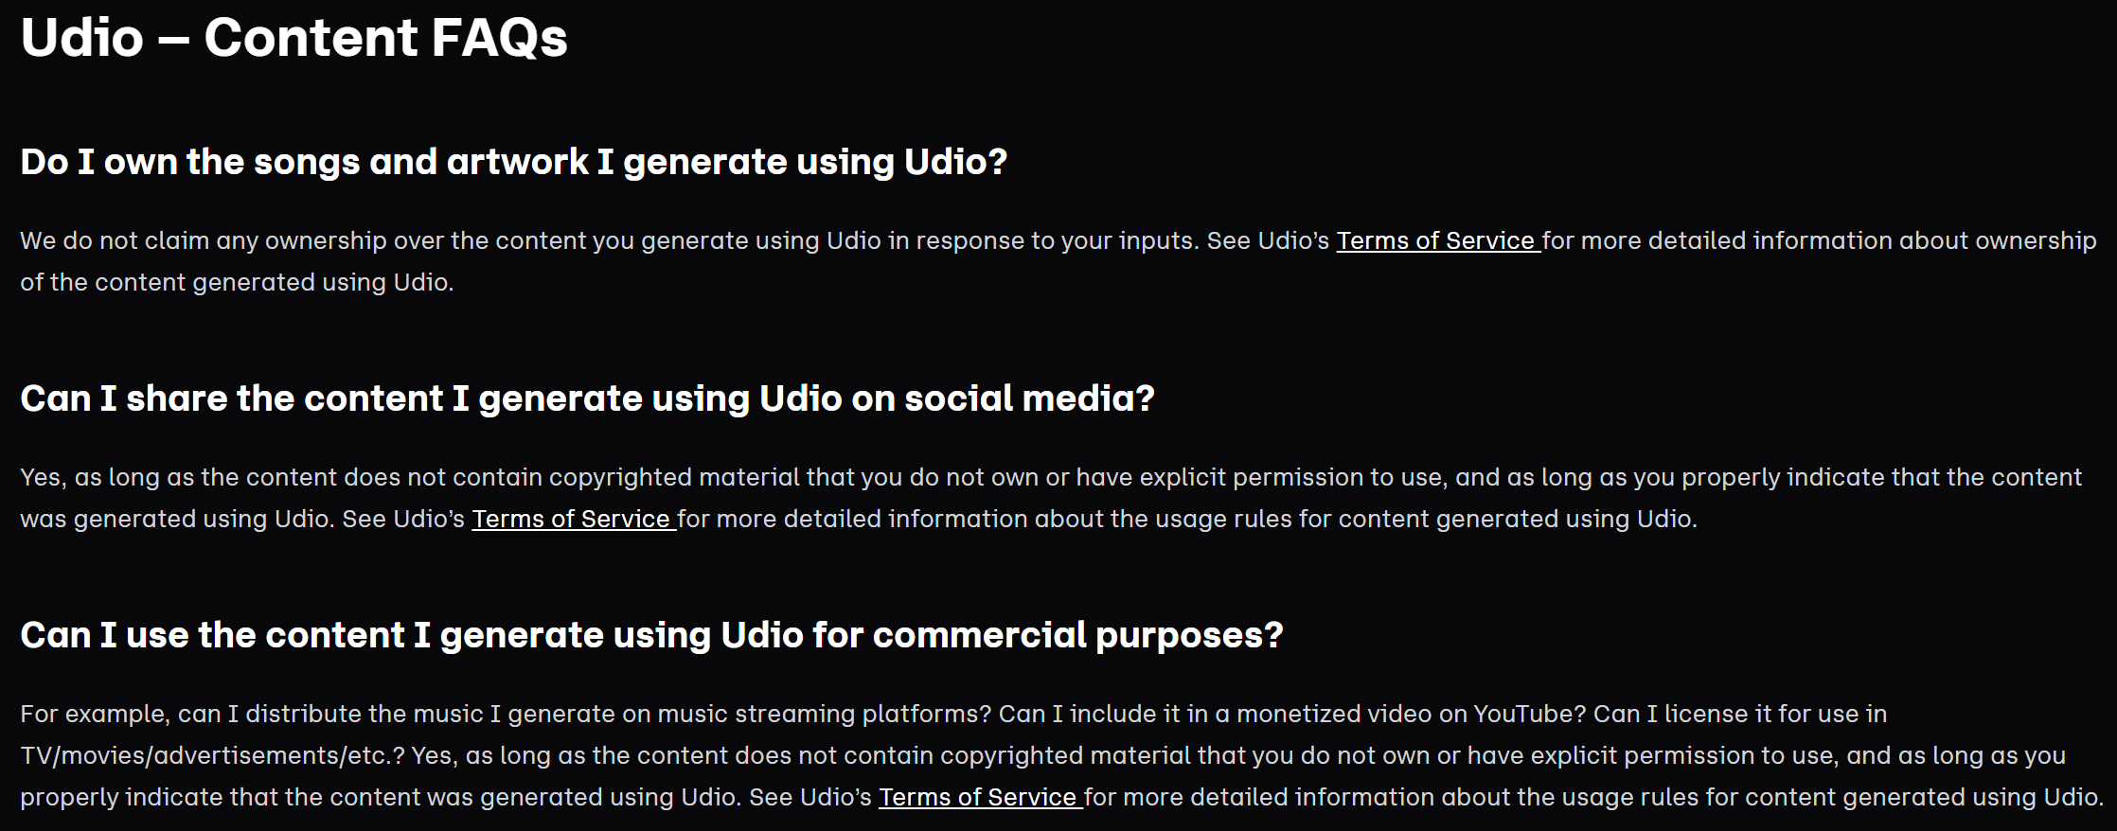
Notes:
https://www.udio.com/faq

Slide 6
Getting Started

Slide 7
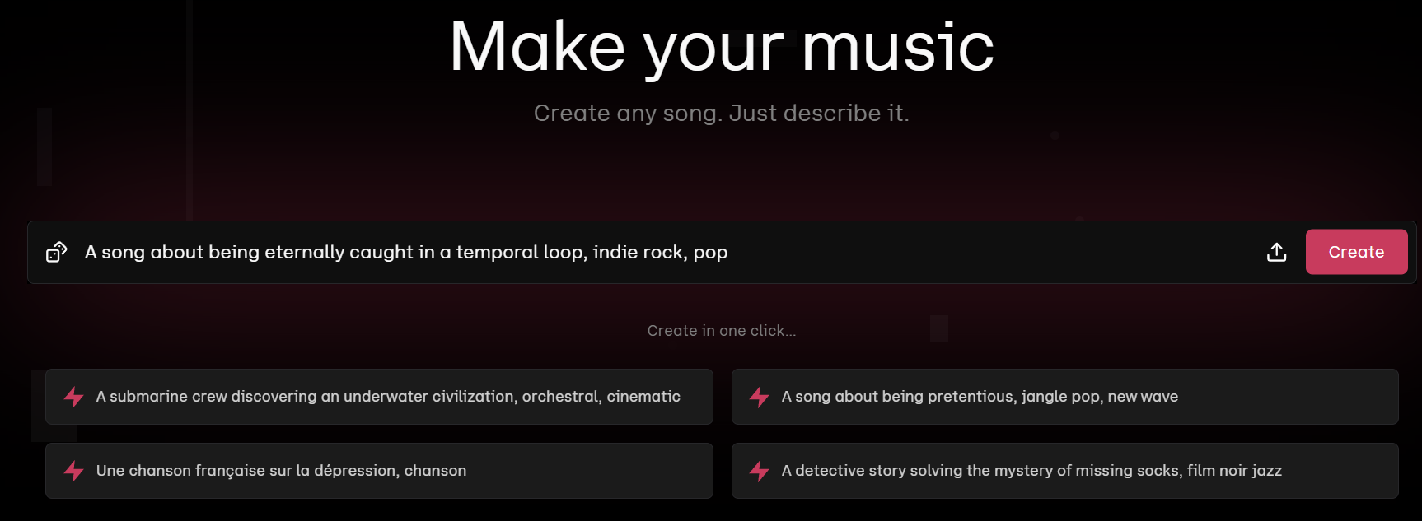
Notes:
https://www.udio.com/

Slide 8
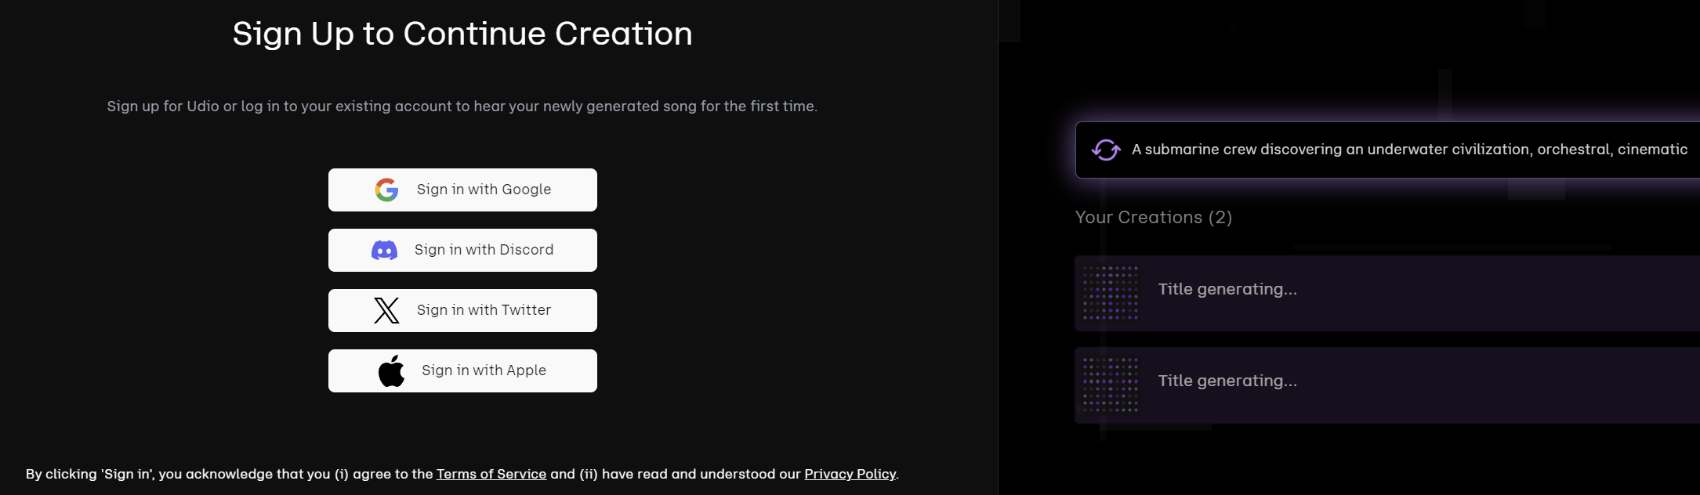

Slide 9
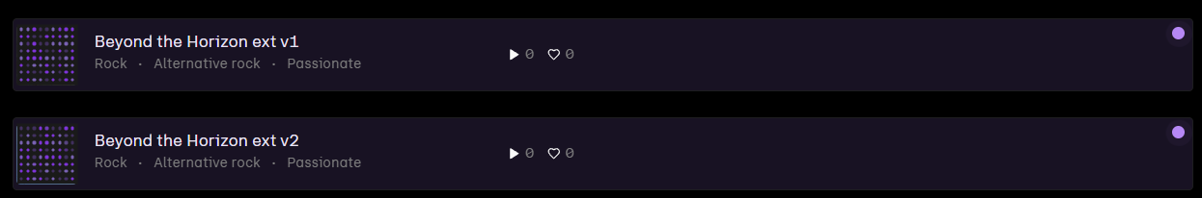

Slide 10
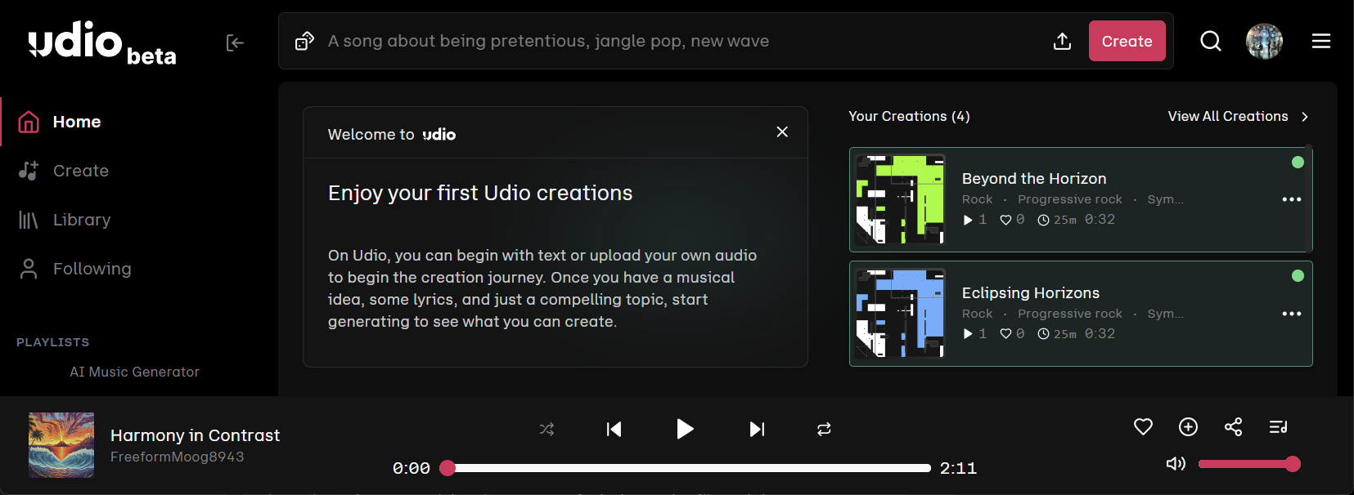

Slide 11
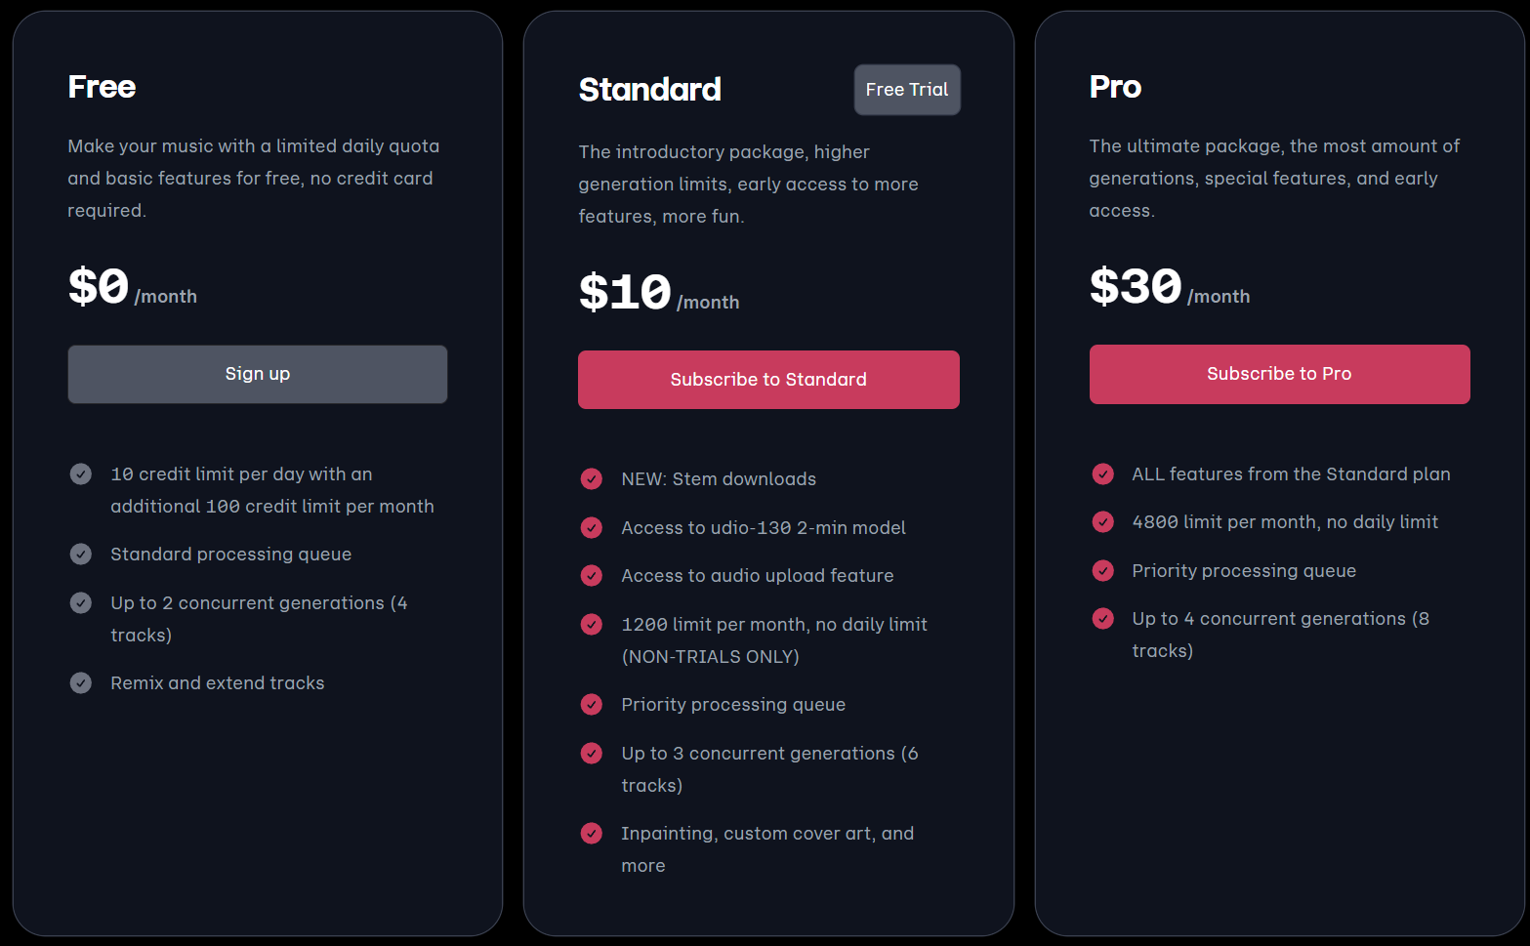
Notes:
https://www.udio.com/pricing

Slide 12
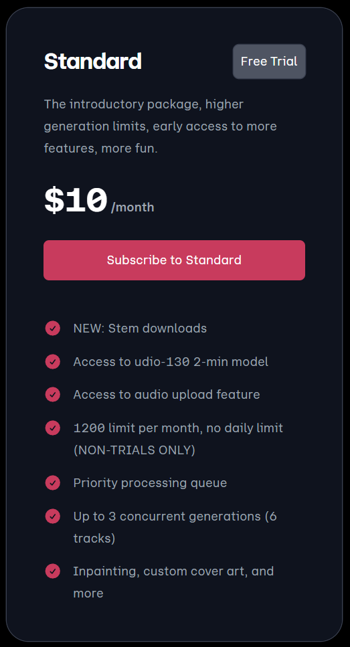

Slide 13




Notes:
https://www.youtube.com/channel/UC35ZpwldGw7ZJ5R-2sLijzw

Slide 14
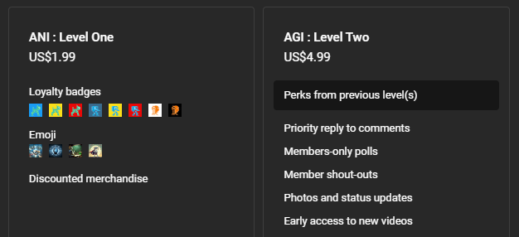

Membership has its privileges
Notes:
https://www.youtube.com/channel/UC35ZpwldGw7ZJ5R-2sLijzw/join

Slide 15

https://www.youtube.com/@AINewsFresh

